Slide 1
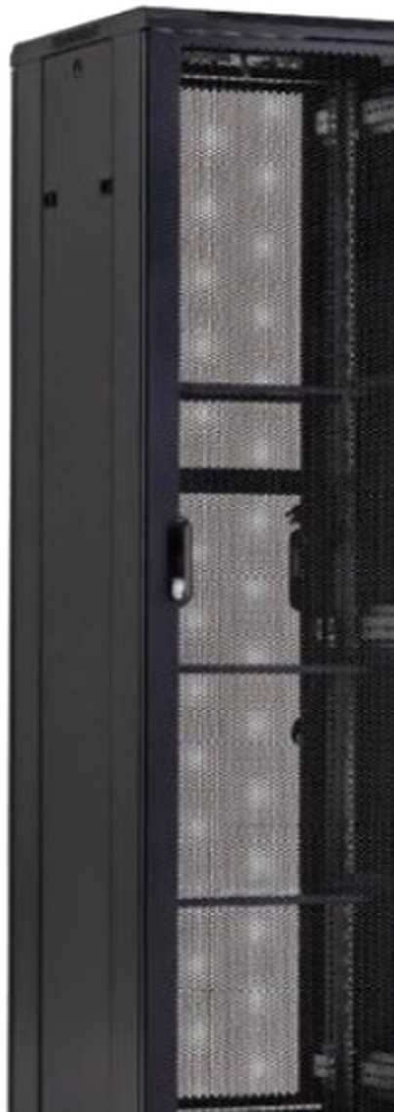
INFINITY
RACK SYSTEMS
DATA INFRASTRUCTURE
PRODUCT CATALOG
19-inch rack platforms, network cabinets, wall-mount systems, open frames and project-engineered infrastructure accessories.
2026 GLOBAL EDITION
RACK METALWORK MANUFACTURED IN TÜRKİYE | NORTH AMERICAN BUSINESS DEVELOPMENT | GULF PROJECT SUPPORT
Infinity Rack Systems - Data Infrastructure Division

Slide 2
COMPANY
Built for fast-moving infrastructure projects
A rack platform combining Türkiye-based metal manufacturing, configurable engineering and coordinated international commercial support.
01
Rack manufacturing in Türkiye
Sheet-metal structures, doors, rails, panels and brackets manufactured and configured for project requirements.
02
North American business development
Customer development and in-person project meetings supported through Chicago and the Midwest.
03
Gulf project support
Commercial coordination for Saudi Arabia and regional data center, telecom and systems-integration opportunities.
ONE BRAND. MULTIPLE SOURCING MODELS.
∞
Rack structures are manufactured in Türkiye. Selected power, monitoring and specialty components can be integrated through qualified OEM partners, giving customers one coordinated configuration, one bill of materials and one commercial interface.
4-47U
19 in
OEM
CURRENT PRODUCT RANGE
GLOBAL EQUIPMENT FORMAT
INTEGRATION MODEL

Slide 3
OVERVIEW
Catalog contents
A structured reference for product selection, technical configuration, customization, manufacturing and project support.
01
Applications & portfolio
Use cases, product families and selection guide
4-6
02
Custom high-density
Project-engineered AI / HPC mechanical platforms
7-8
03
Floor-standing racks
AS Series construction, options and model matrix
9-11
04
Network & wall-mount
NS and WM Series for edge, telecom and structured cabling
12-15
05
Open-frame systems
2-post and 4-post equipment frames
16-17
06
Power & accessories
OEM-integrated PDU, monitoring, cable and airflow options
18-21
07
Engineering & quality
Custom programs, manufacturing and compliance framework
22-24
08
Delivery & support
Packaging, assembly, order process and contact
25-28
All product dimensions are nominal and are confirmed on the project quotation and approved configuration sheet.

Slide 4
APPLICATIONS
Infrastructure for distributed and mission-critical environments
A configurable rack platform for integrators, contractors, distributors and end users across multiple infrastructure segments.
Data centers & colocation
AI / HPC projects
DC
Floor-standing racks, cable management and project-specific accessories
AI
Custom high-load frames and cooling-interface engineering
Telecom & network
Edge & branch IT
TC
Network cabinets, open frames and structured-cabling accessories
ED
Compact floor and wall-mount systems for distributed sites
Security & control
AV & lab systems
SC
CCTV, access control, industrial monitoring and control-room cabinets
AV
Open-frame racks, shelves and high-access service configurations
PROJECT MODEL
Standard families for speed. Custom engineering for fit. OEM integration for electrical and monitoring options.

Slide 5
PORTFOLIO
A modular product architecture
Established rack families are combined with project-specific accessories, OEM-integrated power options and custom mechanical engineering.
HX
Custom High-Density Racks
AS
Floor-Standing Racks
Project-specific AI / HPC mechanical platforms
Enterprise and data room deployments
ENGINEERING PROGRAM
AVAILABLE
NS
Network Cabinets
WM
Wall-Mounted Cabinets
Compact to full-height 19-inch cabinets
Single and double-section solutions
AVAILABLE
AVAILABLE
OF
Open-Frame Racks
PX
Power & Monitoring
2-post and 4-post equipment frames
PDU, sensors and remote visibility
AVAILABLE
OEM-INTEGRATED
CX
Cable & Airflow
EX
Custom Engineering
Management, blanking and containment
Private label, dimensions and finishes
AVAILABLE
AVAILABLE
Portfolio principle
Manufacture the structure. Integrate the options. Deliver one coordinated system.

Slide 6
SELECTION GUIDE
Choose by environment, density and service model
Compare each product family by installation type, capacity, structural load and supply model.
Family | Best fit | Typical U | Load rating | Supply model
HX Custom | AI / HPC, liquid-ready mechanical projects | 42-52U | Project-defined | Custom engineering
AS Floor Standing | Server rooms, enterprise, colocation | 18-47U | Up to 800 kg | Manufactured
NS Network | Telecom, structured cabling, edge rooms | 4-42U | 60-800 kg by model | Manufactured
WM Wall Mounted | Branch IT, CCTV, retail, small networks | 4-18U | Up to 60 kg | Manufactured
OF Open Frame | Labs, telecom, cable-intensive installations | 18-47U | Up to 150 kg | Manufactured
PX Power & Monitoring | PDU, metering, sensors, remote alerts | 1U / 0U | By OEM component | OEM-integrated
Specify your project in three steps
1
Environment
Wall, floor, open-frame, edge or data room
2
Mechanical
U height, width, depth, load and door type
3
Options
PDU, shelves, cable management, cooling and packing

Slide 7
HX SERIES
CUSTOM ENGINEERING
Custom high-density rack engineering
Project-specific mechanical platforms for high-load compute, advanced cable architecture and liquid-cooling-ready installations.
Typical envelope
42-52U; 800 mm width; 1,200-1,400 mm depth
Structural load
Defined and validated for the approved project configuration
Airflow
High-open-area perforated front and split rear doors
Power
0U / 1U three-phase intelligent PDU integration
Cooling readiness
Rear-door heat exchanger and blind-mate manifold options
Monitoring
Temperature, humidity, door and leak sensing
Cable architecture
Large top entry, overhead ladders and side channels
Compliance scope
Model-specific testing or evaluation defined in the project plan
Why separate it from the standard rack line?
FRONT
Each HX project is released against approved drawings, a defined load case, cable and cooling interfaces, and a project-specific verification plan. Standard rack components are used only where technically appropriate.
48-52U
high-density frame

Slide 8
HX SERIES
Project engineering workflow
A controlled development process converts site requirements into an approved, manufacturable and verifiable rack configuration.
01
Requirements definition
Equipment dimensions, load, power, cooling, cable entry and site constraints
Project start
02
Mechanical design
Frame, doors, rails, cable zones, brackets, base and service clearances
Design
03
Prototype & review
Fit checks, access, assembly, transport method and customer design review
Prototype
04
Component integration
PDU, sensors, manifold or rear-door interfaces and cable harness coordination
Integration
05
Verification plan
Load, stability, coating, packaging and market-specific documentation scope
Verification
06
Pilot release
Controlled pilot production followed by revision closure and serial production
Release
Project release rule
Production begins only after drawing approval, configuration sign-off and agreement on the verification and documentation package.

Slide 9
AS SERIES
AVAILABLE PRODUCT FAMILY
Floor-standing server racks
Configurable 19-inch cabinets for enterprise server rooms, telecom environments and conventional data center deployments.
18-47U
600/800
800 kg
HEIGHT RANGE
WIDTH mm
STATIC LOAD
Mounting format
19-inch equipment rails; depth-adjustable profiles
Depth options
600 / 800 / 1,000 / 1,200 mm
Door options
Toughened glass, perforated mesh, split rear doors
Material
Cold-rolled sheet steel; typical 2.0 / 1.2 / 1.0 mm structure
Finish
Degreasing / pretreatment / powder coating
Cable entry
Top and bottom knock-outs or brush-panel openings
Protection
IP20 standard indoor configuration
Packing
Assembled or knock-down packaging by model
AS-MESH
Best fit
Enterprise IT rooms, colocation fit-outs, telecom, education, healthcare and industrial control environments.

Slide 10
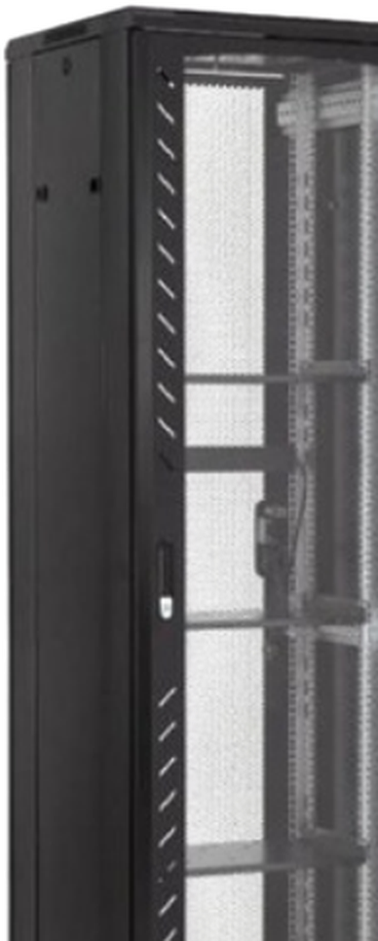
AS SERIES
Construction and configuration options
A modular cabinet architecture supports door, rail, cable-entry, base and accessory changes without redesigning the complete platform.
01
Frame & roof
Rigid knock-down or assembled structure with removable roof and base panels
02
19-inch rails
Front and rear mounting profiles, depth-adjustable for equipment support
03
Door system
Toughened glass or perforated front; single or split rear configurations
04
Side access
Removable and lockable panels for installation and service
05
Cable entry
Top and bottom knock-outs, brush panels or project-specific cut-outs
06
Base options
Casters, leveling feet, plinths, anchoring points and transport skids
07
Accessory zones
0U PDU, vertical cable managers, fan trays, shelves and grounding kits
Configuration is frozen through the approved drawing and order code before production.

Slide 11
AS SERIES
Model and configuration matrix
A consistent ordering structure makes product selection, quotations and repeat orders easier.
U | Nominal height | Width | Depth options | Standard package
18U | ~987 mm | 600 mm | 600 / 800 / 1,000 mm | 2 fans + 1 shelf
22U | ~1,164 mm | 600 / 800 mm | 600 / 800 / 1,000 mm | 2 fans + 1 shelf
27U | ~1,387 mm | 600 / 800 mm | 600 / 800 / 1,000 mm | 2 fans + 1 shelf
32U | ~1,609 mm | 600 / 800 mm | 600 / 800 / 1,000 mm | 4 fans + 1 shelf
37U | ~1,832 mm | 600 / 800 mm | 600 / 800 / 1,000 mm | 4 fans + 1 shelf
42U | ~2,054 mm | 600 / 800 mm | 600 / 800 / 1,000 / 1,200 mm | 4 fans + 1 shelf
47U | ~2,276 mm | 600 / 800 mm | 800 / 1,000 / 1,200 mm | 4 fans + 1 shelf
Ordering code
AS - 42 - 08 - 10 - M - K
AS
42
08
10
M
K
family
rack units
800 mm width
1,000 mm depth
mesh doors
knock-down
Final heights and usable mounting depths must be confirmed on the signed project datasheet.

Slide 12
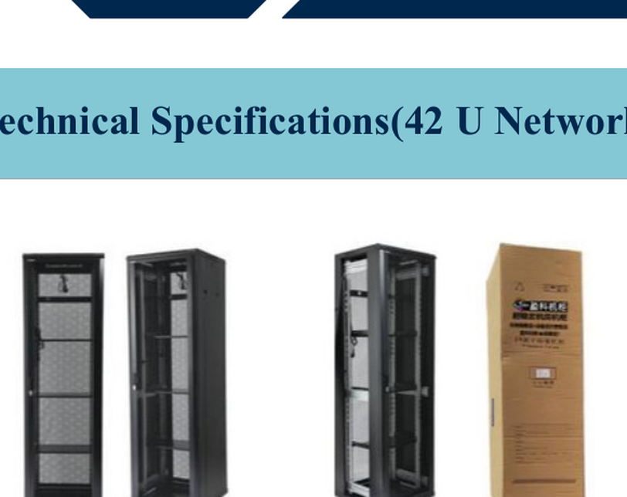
NS SERIES
AVAILABLE PRODUCT FAMILY
Network and edge cabinets
A broad 19-inch portfolio for structured cabling, edge compute, CCTV, telecom and compact server-room applications.
Compact
Mid-size
Full-height
4-12U
18-32U
42U
600 x 450 mm
600 x 600-900 mm
600/800 x 600-1,000 mm
Retail, CCTV, small network
Edge rooms and branch IT
Network and server rooms
Standard configuration options
Perforated or glass front door
Removable side panels and lockable doors
Adjustable 19-inch rails and cable-entry knock-outs
Fan trays, shelves, casters, leveling feet and PDU options

Slide 13
NS SERIES
Representative network cabinet range
Standard dimensions and configurations can be adapted through approved project drawings and ordering suffixes.
Model | U | W x D x H (mm) | Application
NS-04-060-045 | 4U | 600 x 450 x 280 | Compact wall / counter installation
NS-09-060-045 | 9U | 600 x 450 x 500 | CCTV and structured cabling
NS-12-060-045 | 12U | 600 x 450 x 635 | Branch IT and access networks
NS-18-060-060 | 18U | 600 x 600 x 900 | Edge room / compact floor cabinet
NS-22-060-060 | 22U | 600 x 600 x 1,200 | Telecom and branch server room
NS-27-060-060 | 27U | 600 x 600 x 1,400 | Network distribution
NS-32-060-060 | 32U | 600 x 600 x 1,600 | Mid-size IT room
NS-42-060-060 | 42U | 600 x 600 x 2,000 | Network cabinet
NS-42-060-100 | 42U | 600 x 1,000 x 2,000 | Deeper server configuration
NS-42-080-080 | 42U | 800 x 800 x 2,000 | High-cable-volume installation
Configuration note
PDU outlet format, fan quantity, shelf count and packaging style are selected as configuration suffixes and confirmed in the quotation.

Slide 14
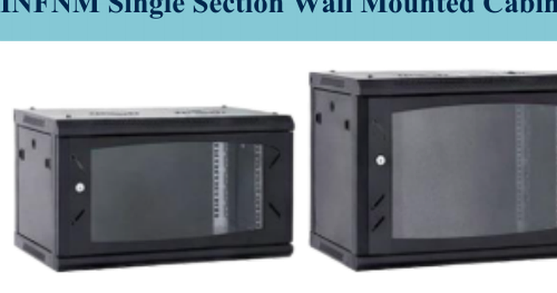
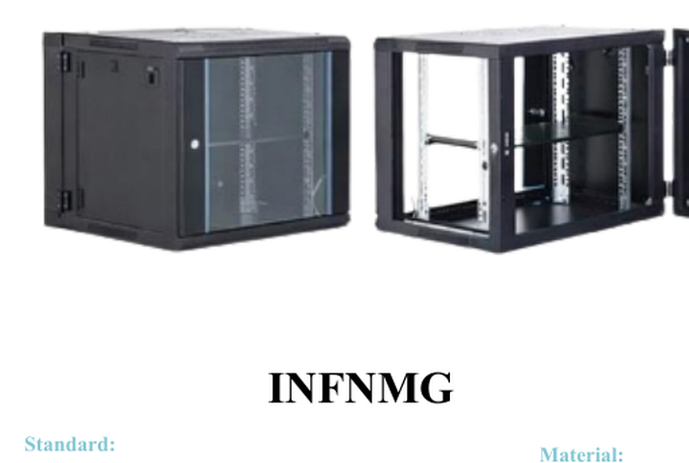
WM SERIES
AVAILABLE PRODUCT FAMILY
Wall-mounted cabinets
Compact, transport-efficient cabinets for structured cabling, security systems, retail, branch networks and light edge equipment.
WM-S | Single section
WM-D | Double section
Capacity
4U to 18U
Project-friendly options
Width
600 mm
Flat-pack shipment to reduce volume
Removable side panels
130° to 180° door-opening options
Fan cut-outs and roof fan trays
Fixed and sliding shelves
Regional PDU integration
Branding, color and private-label packaging
Depth
450 / 600 mm
Static load
Up to 60 kg
Front door
Toughened glass or perforated
Rear access
Fixed rear / hinged double-section
Cable entry
Top, bottom and rear knock-outs
Knock-down packaging, removable panels and configurable accessories make this family well suited to distributor stock and project-based integration.
Finish
Powder-coated cold-rolled sheet steel

Slide 15
WM SERIES
Wall-mount selection matrix
Single-section models prioritize compactness; double-section models provide rear service access and improved installation flexibility.
Family | Capacity | Width | Depth | Rear access | Static load
WM-S04 / WM-D04 | 4U | 600 mm | 450 / 600 mm | Fixed / hinged | Up to 60 kg
WM-S06 / WM-D06 | 6U | 600 mm | 450 / 600 mm | Fixed / hinged | Up to 60 kg
WM-S09 / WM-D09 | 9U | 600 mm | 450 / 600 mm | Fixed / hinged | Up to 60 kg
WM-S12 / WM-D12 | 12U | 600 mm | 450 / 600 mm | Fixed / hinged | Up to 60 kg
WM-S15 / WM-D15 | 15U | 600 mm | 450 / 600 mm | Fixed / hinged | Up to 60 kg
WM-S18 / WM-D18 | 18U | 600 mm | 450 / 600 mm | Fixed / hinged | Up to 60 kg
Ordering suffixes
S
D
G
M
K
A
Single section
Double section
Glass door
Perforated door
Knock-down pack
Assembled pack
Example: WM-D12-060-060-M-K

Slide 16
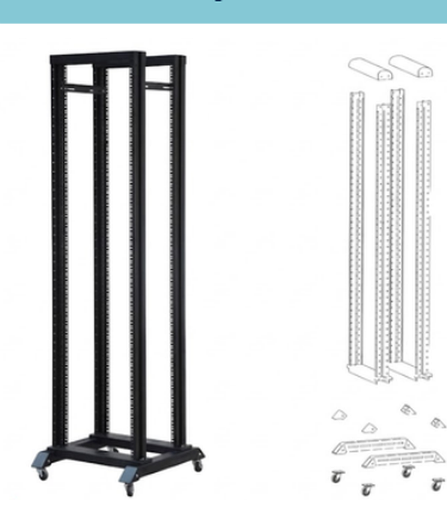
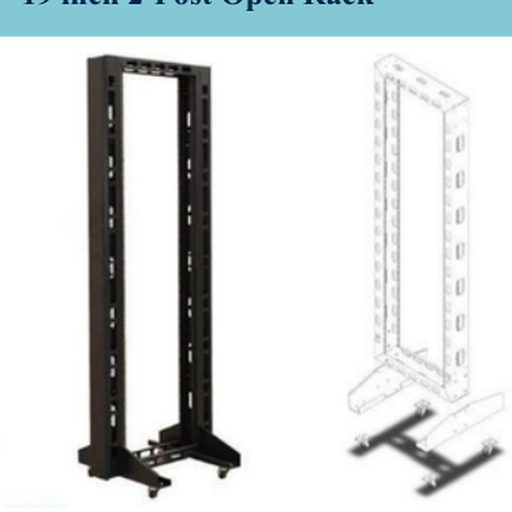
OF SERIES
AVAILABLE PRODUCT FAMILY
2-post and 4-post open-frame racks
Fast access, simple installation and low material complexity for labs, telecom, audio/video and cable-intensive deployments.
OF-2P
OF-4P
18-47U
600 mm
150 kg
2.0 mm
HEIGHTS
WIDTH
STATIC LOAD
PRIMARY STEEL
Recommended add-ons
Heavy-duty base or caster kit
Vertical cable managers and lacing bars
Grounding / bonding kit
Wall or floor anchoring package
Equipment shelves and stabilizer brackets

Slide 17
OF SERIES
Open-frame model matrix
Select the 2-post configuration for cable-centric equipment and the 4-post configuration for deeper or four-point-mounted equipment.
Model family | Capacity | Width | Construction | Nominal load | Typical use
OF-2P18 / OF-4P18 | 18U | 600 mm | 2.0 mm primary steel | Up to 150 kg | Lab / AV / telecom
OF-2P22 / OF-4P22 | 22U | 600 mm | 2.0 mm primary steel | Up to 150 kg | Access networks
OF-2P27 / OF-4P27 | 27U | 600 mm | 2.0 mm primary steel | Up to 150 kg | Telecom rooms
OF-2P32 / OF-4P32 | 32U | 600 mm | 2.0 mm primary steel | Up to 150 kg | Network distribution
OF-2P37 / OF-4P37 | 37U | 600 mm | 2.0 mm primary steel | Up to 150 kg | Equipment rooms
OF-2P42 / OF-4P42 | 42U | 600 mm | 2.0 mm primary steel | Up to 150 kg | Full-height installation
OF-2P47 / OF-4P47 | 47U | 600 mm | 2.0 mm primary steel | Up to 150 kg | High-capacity cabling
INSTALLATION NOTE
Floor anchoring, stabilizer brackets and equipment center-of-gravity must be evaluated for the actual installation. Load ratings are confirmed against the ordered configuration.

Slide 18
PX SERIES
OEM-INTEGRATED
Power distribution and monitoring
Qualified OEM power and sensing components can be mechanically integrated, labeled and supplied as part of the complete rack configuration.
P
Basic PDU
M
Metered PDU
1U / 0U
0U preferred
Regional socket options; project-specific cord and plug
Local current, voltage and power display
S
Switched PDU
E
Environmental hub
0U preferred
1U / magnetic
Remote outlet control and load sequencing
Temperature, humidity, door and leak sensors
Integration and documentation checklist
Component documentation appropriate to the destination market
Defined warranty and traceable serial numbers
Stable firmware and documented communication protocol for intelligent models
Spare-part availability and replacement process
Mechanical drawings for mounting and cable-clearance validation
Certificates and declarations supplied for the selected component where applicable
Branding and documentation are defined in the project quotation and remain subject to the selected OEM component scope.

Slide 19
PX SERIES
PDU and monitoring selection framework
Electrical ratings, plugs, outlets, communication and certification are selected for the destination market and confirmed on the OEM component datasheet.
Option | Installation | Function | Typical interface | Project inputs
Basic PDU | 1U / 0U | Outlet distribution | Local power only | Voltage, plug, outlet type, cord
Metered PDU | 0U preferred | Local electrical measurement | Display | Phase, current range, outlet count
Monitored PDU | 0U preferred | Remote load visibility | Ethernet / serial by OEM | Protocol, network, alarm rules
Switched PDU | 0U preferred | Remote outlet control | Ethernet / serial by OEM | Sequencing, outlet grouping, security
Environmental hub | 1U / magnetic | Temperature / humidity / door / leak | Sensor bus by OEM | Sensor quantity and placement
Market
U.S. / EU / Gulf
Electrical
Voltage, phase, frequency
Input
Plug or hard-wire requirement
Output
Outlet type and quantity
Monitoring
Display, SNMP, Modbus or other
Documentation
Requested certificates and declarations
Electrical accessories are supplied according to the approved OEM datasheet; rack certification does not automatically cover integrated electrical components.

Slide 20
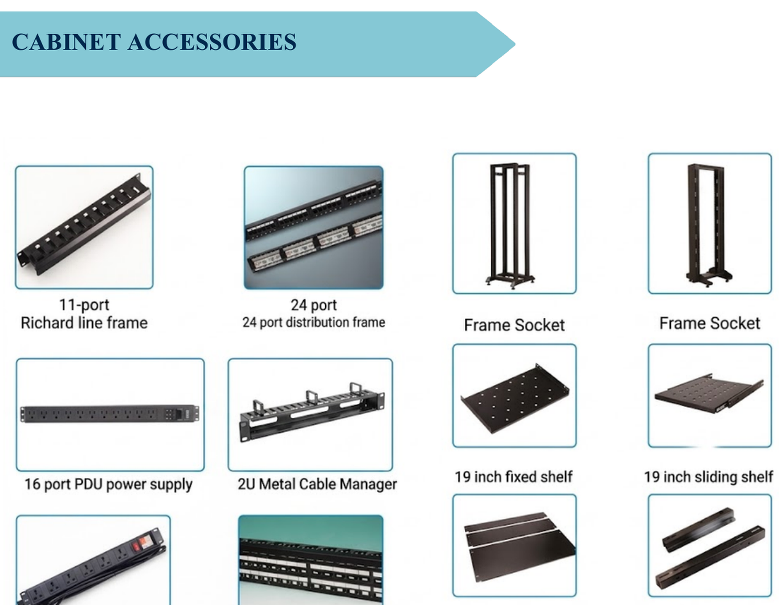
CX SERIES
Cable and airflow management
Small accessories often decide whether an integrator views a rack as a finished system or only a sheet-metal enclosure.
Cable management
Airflow management
1U / 2U horizontal managers
Vertical lacing rails
Brush-entry panels
Cable rings and tie points
1U / 2U blanking panels
Fan trays and roof modules
Perforated shelves
Front-to-rear separation kits
Mechanical accessories
Grounding & security
Fixed / sliding shelves
Cantilever trays
Heavy-duty casters
Leveling feet and anchors
Bonding conductors
Door earth straps
Lock options
Grounding studs and labels

Slide 21
CX SERIES
Accessory ordering matrix
Accessory dimensions and load ratings are matched to the selected cabinet width, depth, rail spacing and equipment requirement.
Category | Product | Typical sizes | Selection note
Cable | Horizontal cable manager | 1U / 2U | Ring, brush or covered style
Cable | Vertical cable manager | Rack-height specific | Width and door clearance required
Airflow | Blanking panel | 1U / 2U | Tool-less or screw-mounted
Airflow | Roof fan tray | 2 / 4 / 6 fan | Voltage and plug by market
Support | Fixed shelf | Depth-specific | Load and rail spacing required
Support | Sliding shelf | Depth-specific | Extension and load required
Support | L-rail / support rail | Depth-adjustable | Equipment weight and chassis depth
Security | Lock and handle set | Door-specific | Keying and access requirements
Grounding | Bonding kit | Rack-specific | Doors, side panels and frame
Base | Caster / foot / plinth kit | Rack-specific | Mobility, leveling and anchoring
ACCESSORY RULE
Accessories are confirmed on the same configuration sheet as the cabinet to avoid width, depth, rail-spacing or electrical incompatibility.

Slide 22
EX SERIES
Custom engineering and OEM programs
Turn manufacturing flexibility into a commercial advantage without creating uncontrolled product variation.
01
Dimensions
02
Doors
Custom width, depth, height and rail spacing
Glass, perforated, split, hinged left/right
03
Branding
04
Interfaces
Logo plates, labels, color and packaging
Cable cut-outs, fan plates, PDU brackets
05
Packing
06
Documentation
Assembled, knock-down or project kits
2D drawings, BOM, installation and packing instructions
Design-control rule
Every customization receives a revision-controlled drawing, signed specification and unique model suffix before production.
Inquiry
Drawing
Approval
Prototype
Production
QC / Ship

Slide 23
MANUFACTURING
A controlled production system in Türkiye
Sheet-metal manufacturing is combined with revision control, incoming inspection, repeatable assembly and export-ready packaging.
01
Material receiving
02
Cutting / punching
Steel grade and thickness verification
Laser, turret punch or CNC cutting
03
Forming
04
Joining
Press-brake bending and profile control
Welding, clinching and mechanical fastening
05
Surface preparation
06
Powder coating
Cleaning, pretreatment and drying
Color, coating thickness and cure control
07
Assembly
08
Final inspection
Rails, doors, locks, fans and accessories
Dimensions, function, load sample and packing
Integrated supply model
Frames, panels, doors, rails and brackets are manufactured as the core platform. Locks, fans, casters, PDU, sensors and specialty interfaces are selected from qualified suppliers and integrated under the approved bill of materials.

Slide 24
QUALITY
Verification and compliance framework
Compliance and certification are model-, configuration- and destination-market specific; the applicable documentation is confirmed in writing.
IEC 60297 family
Dimensional practices for 482.6 mm / 19-inch mechanical structures
IEC 60529
IP classification methodology for enclosures
UL 2416
North American safety standard path for cabinet, enclosure and rack systems
OCP Open Rack V3
Separate 21-inch / busbar-based architecture for hyperscale and AI systems
Quality management
Inspection plans, revision control, traceability and nonconformance handling
Electrical options
Declarations and certificates depend on the selected OEM electrical component
Project documentation pack
Approved drawing, configuration sheet, packing list and applicable supplier declarations are issued according to the project scope.

Slide 25
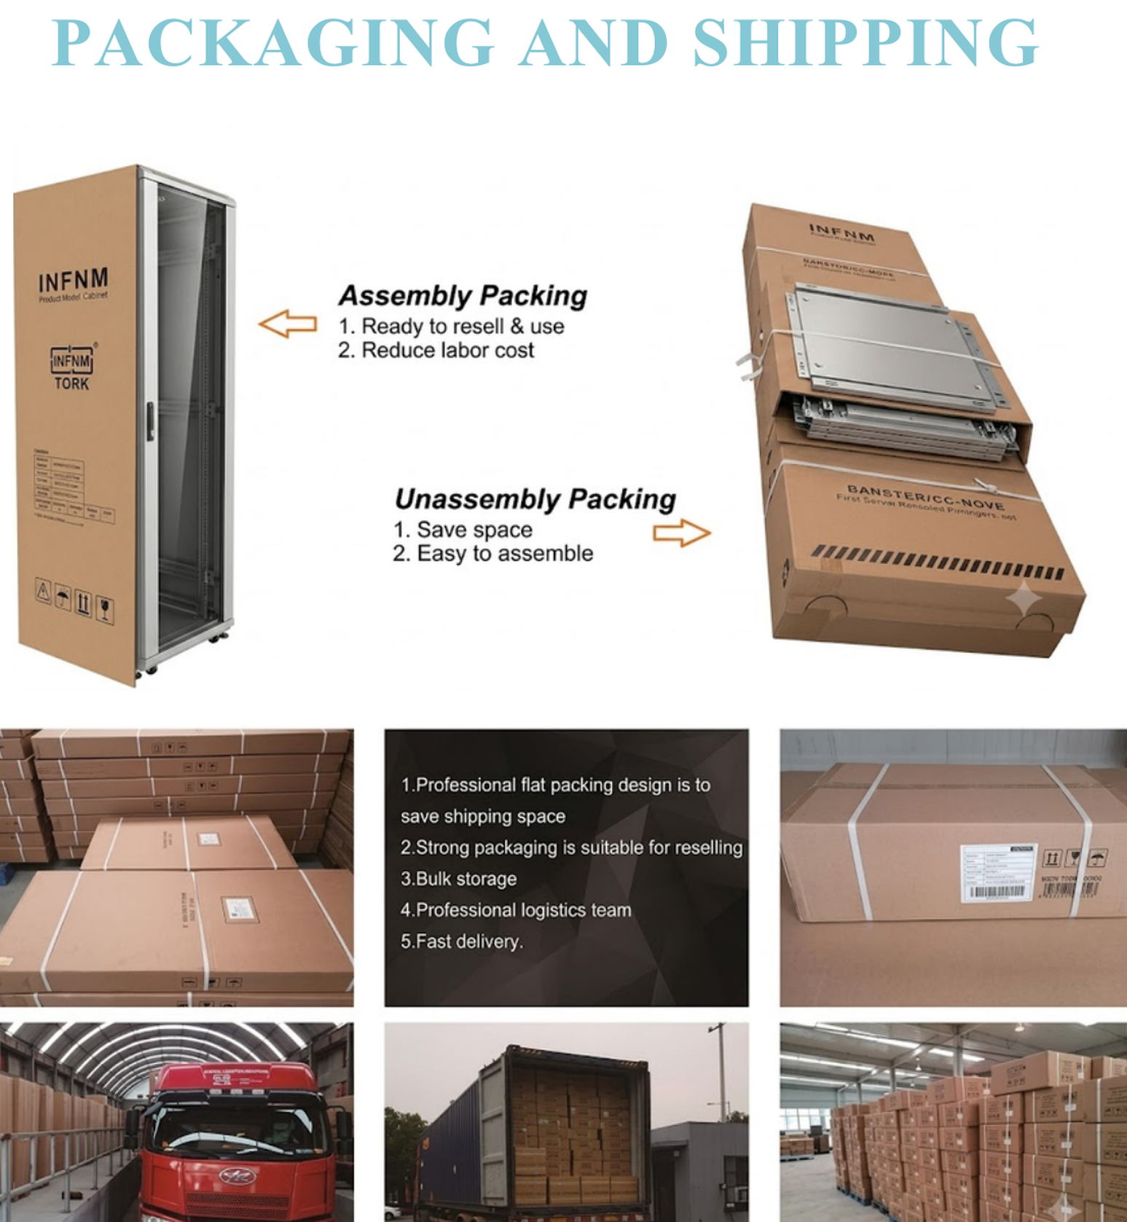
LOGISTICS
Packaging for export and rapid deployment
Product geometry and packing strategy directly affect freight cost, damage rate and distributor willingness to hold stock.
Assembled
Fast installation
Higher freight volume
Knock-down
Lower cubic volume
Local assembly required
Project kit
Rack + accessories
Site-specific labeling
U.S. stock
Fast Midwest delivery
Forecast and inventory discipline
Export packaging checklist
Corner protection
Moisture barrier
Part labeling
Assembly guide
Pallet / carton test

Slide 26
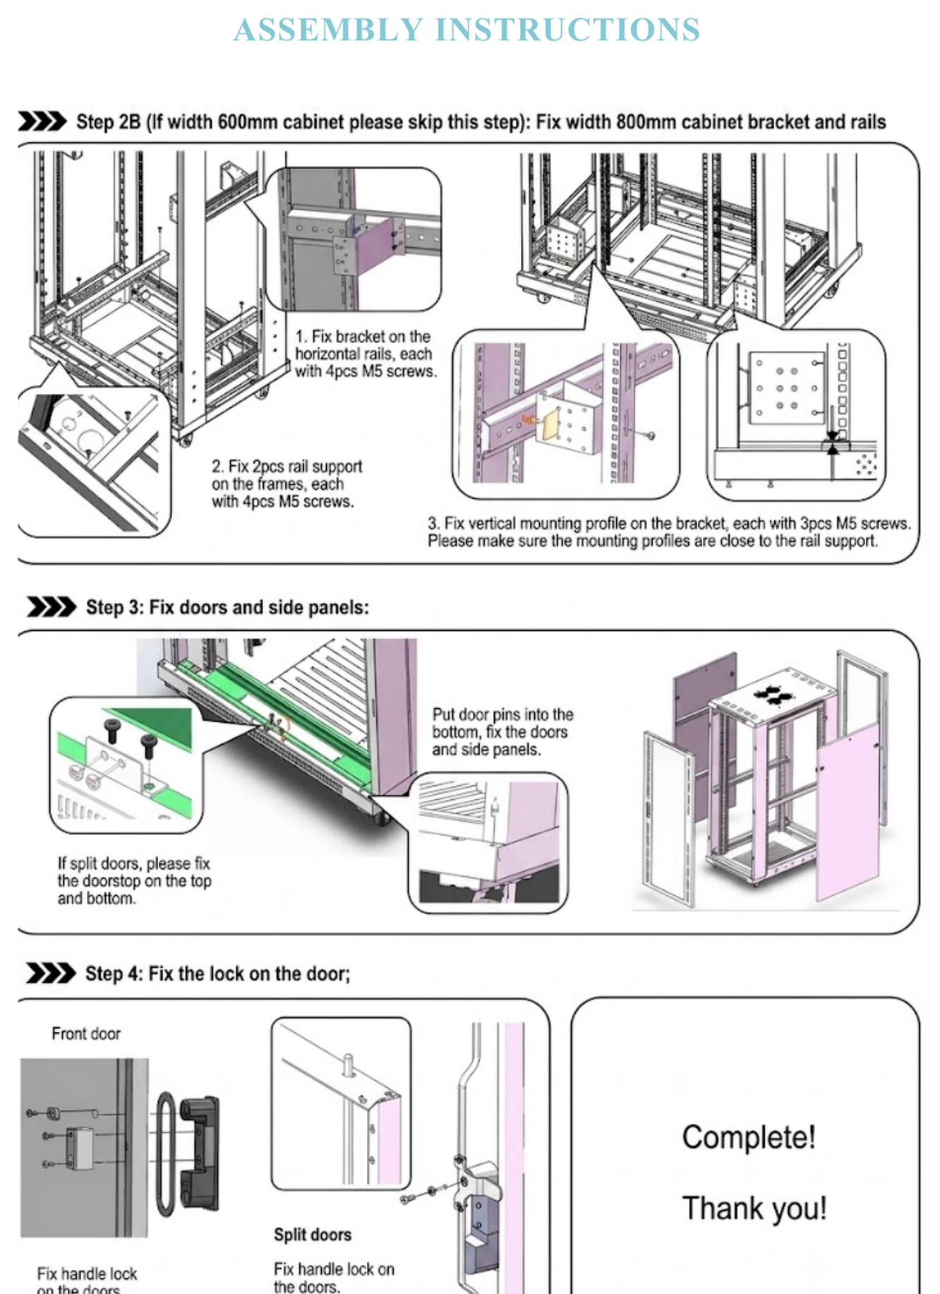
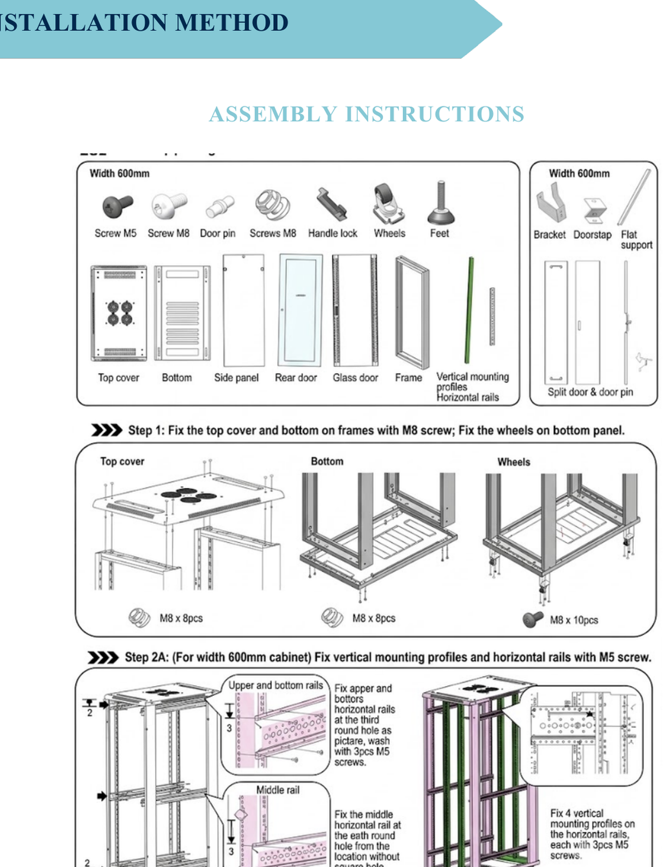
SERVICE
Assembly, documentation and lifecycle support
Clear instructions, labeled components and defined support channels simplify installation and long-term service.
Installation
Parts
Support
Warranty
Illustrated assembly sequence and torque guidance
Exploded view, BOM and spare-part identification
Commercial and technical coordination through the assigned representative
Terms and duration confirmed in the quotation and order acknowledgement

Slide 27
COMMERCIAL PROCESS
From inquiry to delivery
A defined configuration and approval workflow reduces technical ambiguity and supports repeat orders across multiple locations.
01
Inquiry
Application, dimensions, quantity, destination and required date
02
Configuration
Model code, doors, rails, accessories, PDU and packing method
03
Quotation
Commercial terms, lead time, documentation and delivery scope
04
Approval
Signed quotation, approved drawing or configuration sheet
05
Production & QC
Manufacturing, incoming inspection, assembly and final checks
06
Packing & delivery
Labeled shipment, packing list and installation documentation
Commercial terms
Payment, Incoterms, delivery schedule, warranty duration and after-sales scope are confirmed in the quotation and order acknowledgement.

Slide 28
INFINITY
RACK SYSTEMS
Configure your next rack project.
Share the installation type, U height, width, depth, equipment load, door style, accessories, quantity and delivery location.
CONTACT
+90 216 784 02 98
infinity@infinityivd.com
Yukarı Dudullu Mah. Alemdağ Cad. Hira İş Hanı
Blok No: 742A, Ümraniye / Istanbul, Türkiye
Commercial coverage
Türkiye | North America | Saudi Arabia & Gulf | European
All dimensions are nominal. Product images are illustrative. Configurations, origin declarations, lead times, accessories, compliance documentation, warranty and delivery terms are confirmed in the quotation and order acknowledgement. Specifications may be improved without prior notice.
© 2026 Infinity IVD. Data Infrastructure Division. All rights reserved.

